Slide 1
Test Driven Development
Unrestricted

Slide 2
Agenda
Why Test Driven Development
Test Driven Development Principle
Demo/Hands On

Slide 3
Different type of Test
Acceptance: Does the whole system work?
Integration: Does our code work against the code we can't change?
Unit: Do our objects do the right thing, are they convenient to work with?

Slide 4
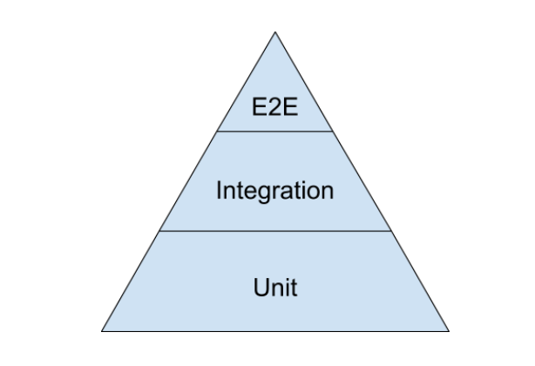
Test Pyramid
Notes:
For much of my career test automation meant tests that drove an application through its user-interface. Such tools would often provide the facility to record an interaction with the application and then allow you to play back that interaction, checking that the application returned the same results. Such an approach works well initially. It's easy to record tests, and the tests can be recorded by people with no knowledge of programming.
But this kind of approach quickly runs into trouble, becoming an ice-cream cone. Testing through the UI like this is slow, increasing build times. Often it requires installed licences for the test automation software, which means it can only be done on particular machines. Usually these cannot easily be run in a "headless" mode, monitored by scripts to put in a proper deployment pipeline.
Most importantly such tests are very brittle. An enhancement to the system can easily end up breaking lots of such tests, which then have to be re-recorded. You can reduce this problem by abandoning record-playback tools, but that makes the tests harder to write. [1] Even with good practices on writing them, end-to-end tests are more prone to non-determinism problems, which can undermine trust in them. In short, tests that run end-to-end through the UI are: brittle, expensive to write, and time consuming to run. So the pyramid argues that you should do much more automated testing through unit tests than you should through traditional GUI based testing. [2]
The pyramid also argues for an intermediate layer of tests that act through a service layer of an application, what I refer to asSubcutaneousTests. These can provide many of the advantages of end-to-end tests but avoid many of the complexities of dealing with UI frameworks. In web applications this would correspond to testing through an API layer while the top UI part of the pyramid would correspond to tests using something like Selenium or Sahi.
The test pyramid comes up a lot in Agile testing circles and while its core message is sound, there is much more to say about building a well-balanced test portfolio. A common problem is that teams conflate the concepts of end-to-end tests, UI tests, and customer facing tests. These are all orthogonal characteristics. For example a rich javascript UI should have most of its UI behavior tested with javascript unit tests using something like Jasmine. A complex set of business rules could have tests captured in a customer-facing form, but run just on the relevant module much as unit tests are.
I always argue that high-level tests are there as a second line of test defense. If you get a failure in a high level test, not just do you have a bug in your functional code, you also have a missing or incorrect unit test. Thus I advise that before fixing a bug exposed by a high level test, you should replicate the bug with a unit test. Then the unit test ensures the bug stays dead

Slide 5
Manual Test
UI
Integration test
Unit
Notes:
Why we should not rely on end to end test : https://testing.googleblog.com/2015/04/just-say-no-to-more-end-to-end-tests.html

Slide 6
TDD can be done at multiple levels – at a feature level (acceptance tests) as well as at a class or module level (unit tests).

Slide 7
TDD Mantra
Red – Write a little test that does not work , and perhaps does not even compile first.
Green – Make the test work quickly , committing whatever sins necessary in the process.
Refactor – Eliminate all of the duplication created in merely getting the test to work.

Slide 8
Why Test Driven Development
Notes:
without a test suite we can not ensure that changes to one part of system did not break other part of system . So defect rate began to rise . As the number of unintended defect rose , we started to fear making changes . We stopped cleaning their production code because they feared the changes would do more harm than good .

Slide 9
Building the right feedback loop
Tests create a feedback loop that informs the developer whether the product is working or not.

Slide 10
The ideal feedback loop has several properties:
It's fast. No developer wants to wait hours or days to find out if their change works. Sometimes the change does not work - nobody is perfect - and the feedback loop needs to run multiple times. A faster feedback loop leads to faster fixes. If the loop is fast enough, developers may even run tests before checking in a change.
It's reliable. No developer wants to spend hours debugging a test, only to find out it was a flaky test. Flaky tests reduce the developer's trust in the test, and as a result flaky tests are often ignored, even when they find real product issues.
It isolates failures. To fix a bug, developers need to find the specific lines of code causing the bug. When a product contains millions of lines of codes, and the bug could be anywhere, it's like trying to find a needle in a haystack.

Slide 11

Clean and Simple Design

Slide 12
TDD helps us to pay attention to the right issue at the right time so we can make our design cleaner . We can refine our design as we learn.
Significantly increase the flexibility of your system, allowing you to keep it clean.
Create a system design that has extremely low coupling.
Notes:
When you follow the three laws and write your tests first, you are faced with a dilemma. Often you know exactly what code you want to write, but the three laws tell you to write a unit test that fails because that code doesn’t exist! This means you have to test the code that you are about to write.
The problem with testing code is that you have to isolate that code. It is often difficult to test a function if that function calls other functions. To write that test you’ve got to figure out some way to decouple the function from all the others. In other words, the need to test first forces you to think about good design.
If you don’t write your tests first, there is no force preventing you from coupling the functions together into an untestable mass. If you write your tests later, you may be able to test the inputs and the outputs of the total mass, but it will probably be quite difficult to test the individual functions.
Therefore, following the three laws, and writing your tests first, creates a force that drives you to a better decoupled design. What professional would not employ tools that drove them toward better designs?
“But I can write my tests later,” you say. No, you can’t. Not really. Oh, you can write some tests later. You can even approach high coverage later if you are careful to measure it. But the tests you write after the fact are defense. The tests you write first are offense. After-the-fact tests are written by someone who is already vested in the code and already knows how the problem was solved. There’s just no way those tests can be anywhere near as incisive as tests written first.

Slide 13
How writing a Test First helps the design

Slide 14
Starting with a test means that we have to describe what we want to achieve before we consider how. This focus helps us maintain the right level of abstraction for the target object.
It also helps us with information hiding as we have to decide what needs to be visible from outside the object.

Slide 15
To keep unit tests understandable (and, so, maintainable), we have to limit their scope.
Unit tests that are dozens of lines long, hiding the point of the test somewhere in its setup. Such tests tell us that the component they’re testing is too large and needs breaking up into smaller components.

Slide 16
To construct an object for a unit test, we have to pass its dependencies to it which encourages context independence, since we have to be able to set up the target object’s environment before we can unit-test.
Notes:
To construct an object for a unit test, we have to pass its dependencies to it, which means that we have to know what they are.
An object with implicit (or just too many) dependencies is painful to prepare for testing—and make a point of cleaning it up.

Slide 17

Courage

Slide 18
TDD enables to gain confidence in code over time . As test accumulate , we gain confidence in the behavior of the system.
Fear of making change disappear
Notes:
Why don’t you fix bad code when you see it? Your first reaction upon seeing a messy function is “This is a mess, it needs to be cleaned.” Your second reaction is “I’m not touching it!” Why? Because you know that if you touch it you risk breaking it; and if you break it, it becomes yours.
But what if you could be sure that your cleaning did not break anything? What if you had the kind of certainty that I just mentioned? What if you could click a button and know within 90 seconds that your changes had broken nothing, and had only done good?
This is one of the most powerful benefits of TDD. When you have a suite of tests that you trust, then you lose all fear of making changes. When you see bad code, you simply clean it on the spot. The code becomes clay that you can safely sculpt into simple and pleasing structures.
When programmers lose the fear of cleaning, they clean! And clean code is easier to understand, easier to change, and easier to extend. Defects become even less likely because the code gets simpler. And the code base steadily improves instead of the normal rotting that our industry has become used to.
What professional programmer would allow the rotting to continue?

Slide 19
If we want to grow a system reliably and to cope with the unanticipated changes that always happen. First, we need constant testing to catch regression errors, so we can add new features without breaking existing ones.
For systems of any interesting size, frequent manual testing is just impractical, so we must automate testing as much as we can to reduce the costs of building, deploying, and modifying versions of the
system.

Slide 20
In some development groups, writing automated tests is seen as not “real” work compared to adding features, and boring as well. Most people do not do as well as they should at work they find uninspiring.
Test-Driven Development (TDD) turns this situation on its head. We write our tests before we write the code. Instead of just using testing to verify our work
after it’s done, TDD turns testing into a design activity. Use the tests to clarify our ideas about what we want the code to do.

Slide 21

Technical Debt

Slide 22
Technical Debt
Doing things the quick and dirty way sets us up with a technical debt, which is similar to a financial debt.
Like a financial debt, the technical debt incurs interest payments, which come in the form of the extra effort that we have to do in future development because of the quick and dirty design choice.
We can choose to continue paying the interest, or we can pay down the principal by refactoring the quick and dirty design into the better design. Although it costs to pay down the principal, we gain by reduced interest payments in the future.
Notes:
Technical debt (also known as design debt or code debt) is a concept in software development that reflects the implied cost of additional rework caused by choosing an easy solution now instead of using a better approach that would take longer.

Slide 23
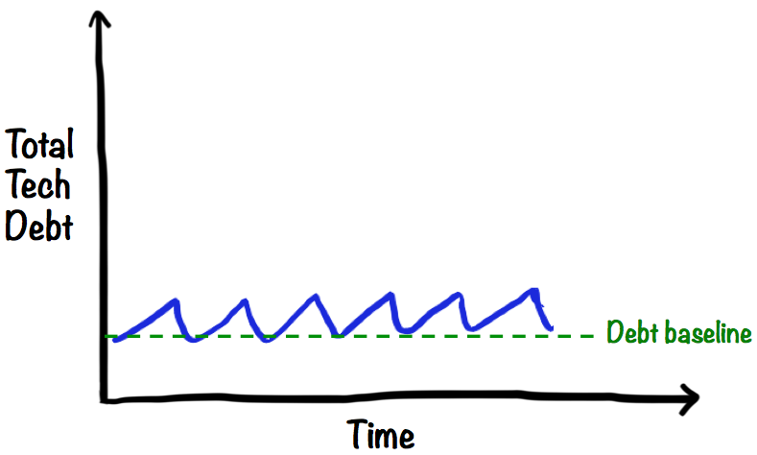

Slide 24

External and Internal Quality

Slide 25
External quality is how well the system meets the needs of its customers and users (is it functional, reliable, available, responsive, etc.),
Internal quality is how well it meets the needs of its developers and administrators (is it easy to understand, easy to change, etc.).

Slide 26
Maintaining internal quality allow us to modify the system’s behavior safely and predictably, because it minimizes the risk that a change will force major rework.
Writing unit tests gives us a lot of feedback about the quality of our code, and running them tells us that we haven’t broken any classes

Slide 27

Documentation

Slide 28
Create a suite of documents that fully describe the low level behavior of the system .
Low level documentation that executes
Notes:
Have you ever used a third-party framework? Often the third party will send you a nicely formatted manual written by tech writers. The typical manual employs 27 eight-by-ten color glossy photographs with circles and arrows and a paragraph on the back of each one explaining how to configure, deploy, manipulate, and otherwise use that framework. At the back, in the appendix, there’s often an ugly little section that contains all the code examples.
Where’s the first place you go in that manual? If you are a programmer, you go to the code examples. You go to the code because you know the code will tell you the truth. The 27 eight-by-ten color glossy photographs with circles and arrows and a paragraph on the back might be pretty, but if you want to know how to use code you need to read code.
Each of the unit tests you write when you follow the three laws is an example, written in code, describing how the system should be used. If you follow the three laws, then there will be a unit test that describes how to create every object in the system, every way that those objects can be created.
There will be a unit test that describes how to call every function in the system every way that those functions can meaningfully be called. For anything you need to know how to do, there will be a unit test that describes it in detail.
The unit tests are documents. They describe the lowest-level design of the system. They are unambiguous, accurate, written in a language that the audience understands, and are so formal that they execute. They are the best kind of low-level documentation that can exist. What professional would not provide such documentation?

Slide 29

Continuous Integration

Slide 30
Continuous Integration is a software development practice where members of a team integrate their work frequently
each person integrates at least daily - leading to multiple integrations per day.
Each integration is verified by an automated build (including test) to detect integration errors as quickly as possible.

Slide 31

Continuous Delivery

Slide 32
What is continuous delivery ?
reduce the cost , time , and risk of
delivering incremental changes
to users
every requirement is a hypothesis

Slide 33
Software always production ready
release tied to business needs , not IT constraints
Minimize the lead time from idea to live
Concept to cash

Slide 34
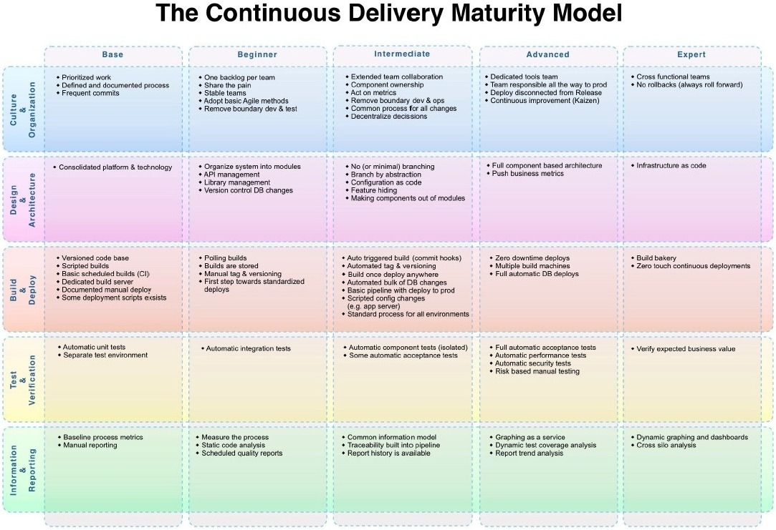

Slide 35





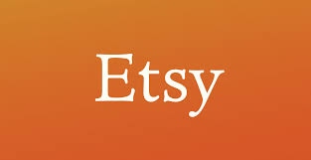

Companies doing Continuous Delivery

Slide 36
Test Driven Development Principle

Slide 37
TDD Mantra
Red – Write a little test that does not work , and perhaps does not even compile first.
Green – Make the test work quickly , committing whatever sins necessary in the process.
Refactor – Eliminate all of the duplication created in merely getting the test to work.

Slide 38
TDD Techniques
TDD with mock objects
Building on third party code
Test Readability
Use Structure to share

Slide 39
TDD with mock objects
TDD with mock objects encourages information hiding. We should mock an object’s peers—its dependencies, notifications, and adjustments but not it’s internals .
Notes:
Dependencies
Services that the object requires from its peers so it can perform its responsibilities.
The object cannot function without these services. It should not be
possible to create the object without them. For example, a graphics package
will need something like a screen or canvas to draw on—it doesn’t make
sense without one.
Notifications
Peers that need to be kept up to date with the object’s activity. The object
will notify interested peers whenever it changes state or performs a significant
action. Notifications are “fire and forget”; the object neither knows nor cares
which peers are listening. Notifications are so useful because they decouple
objects from each other. For example, in a user interface system, a button
component promises to notify any registered listeners when it’s clicked, but
does not know what those listeners will do. Similarly, the listeners expect to
be called but know nothing of the way the user interface dispatches its events.
Adjustments
Peers that adjust the object’s behavior to the wider needs of the system. This
includes policy objects that make decisions on the object’s behalf (the Strategy
pattern in [Gamma94]) and component parts of the object if it’s a composite.
For example, a Swing JTable will ask a TableCellRenderer to draw
a cell’s value, perhaps as RGB (Red, Green, Blue) values for a color. If we
change the renderer, the table will change its
Tests that highlight an object’s neighbors help us to see whether they are peers, or should instead be internal to the target object. A test that is clumsy or unclear might be a hint that we’ve exposed too much implementation, and that we should rebalance the responsibilities between the object and its neighbors.

Slide 40
Building on third party code
Providing mock implementations of third-party types is of limited use when unit-testing the objects that call them. Tests that mock external libraries often need to be complex to get the code into the right state for the functionality we need to exercise.
Write an Adapter Layer .We keep this layer as thin as possible, to minimize the amount of potentially brittle and hard to test code.
*Don't mock what you don't own
Notes:
https://github.com/testdouble/contributing-tests/wiki/Don%27t-mock-what-you-don%27t-own

Slide 41
Test Readability
Teams that adopt TDD usually see an early boost in productivity because the tests let them add features with confidence and catch errors immediately.
For some teams, the pace then slows down as the tests themselves become a maintenance burden. For TDD to be sustainable, the tests must do more than verify the behavior of the code; they must also express that behavior clearly—they must be readable
We should take as much care about writing our test code as about production code.
Notes:
but with differences in style since the two types of code serve different purposes. Test code should describe what the production code does. That means that it tends to be concrete about the values it uses as examples of what results to expect, but abstract about how the code works

Slide 42
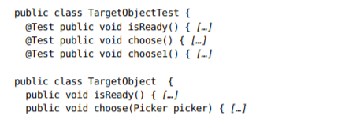
Code Example

Slide 43
such names duplicate the information a developer could get just by looking at the target class; they break the “Don’t Repeat Yourself” principle [Hunt99].
We don’t need to know that TargetObject has a choose() method—we need to know what the object does in different situations, what the method is for.

Slide 44
A better alternative is to name tests in terms of the features that the target object provides.
For example,
A List holds items in the order they were added.
A List can hold multiple references to the same item.
A List throws an exception when removing an item it doesn’t hold.
We can translate these directly to method names.

Slide 45


Slide 46
These names can be as long as we like because they’re only called through reflection—we never have to type them in to call them.
The point of the convention is to encourage the developer to think in terms of what the target object does, not what it is.

Slide 47
Use Structure to share
We also extract common features into methods that can be shared between tests for setting up values, tearing down state, making assertions, and occasionally triggering the event.

Slide 48
Test Structure
1. Setup: prepare the context of the test, the environment in which the target code will run;
2. Execute: call the target code, triggering the tested behavior;
3. Verify: check for a visible effect that we expect from the behavior; and,
4. Teardown: clean up any leftover state that might corrupt other tests.

Slide 49
Keeping Test Clean
Test code is just as important as production code. It is not second class citizen.
What makes test clean
Readability , Clarity , simplicity and density of expression
Notes:
If test is not readable , it’s difficult to understand for new developer . We write test so that it fail in the future when something goes wrong so readability is very important so that we can fix it easily
Follow “Arrange , Act , Assert”

Slide 50
F.I.R.S.T
Fast
Tests should be fast. They should run quickly.
When tests run slow, you won’t want to run them frequently. If you don’t run them frequently, you won’t find problems early enough to fix them easily. You won’t feel as free to clean up the code. Eventually the code will begin to rot.
Independent
Tests should not depend on each other.
One test should not set up the conditions for the next test. You should be able to run each test independently and run the tests in any order you like.
When tests depend on each other, then the first one to fail causes a cascade of downstream failures, making diagnosis difficult and hiding downstream defects.

Slide 51
Repeatable
Tests should be repeatable in any environment. You should be able to run the tests in the production environment, in the QA environment, without a network.
If your tests aren’t repeatable in any environment, then you’ll always have an excuse for why they fail. You’ll also find yourself unable to run the tests when the environment isn’t available.
Self-Validating
The tests should have a boolean output. Either they pass or fail.
You should not have to read through a log file to tell whether the tests pass. If the tests aren’t self-validating, then failure can become subjective and running the tests can require a long manual evaluation.

Slide 52
Timely
The tests need to be written in a timely fashion. Unit tests should be written just before the production code that makes them pass.
If you write tests after the production code, then you may find the production code to be hard to test. You may decide that some production code is too hard to test. You may not design the production code to be testable.

Slide 53
Common test smells
Hard-to-Test Code
Fragile Test
Test Code Duplication
Slow Tests
Conditional Test Logic

Slide 54
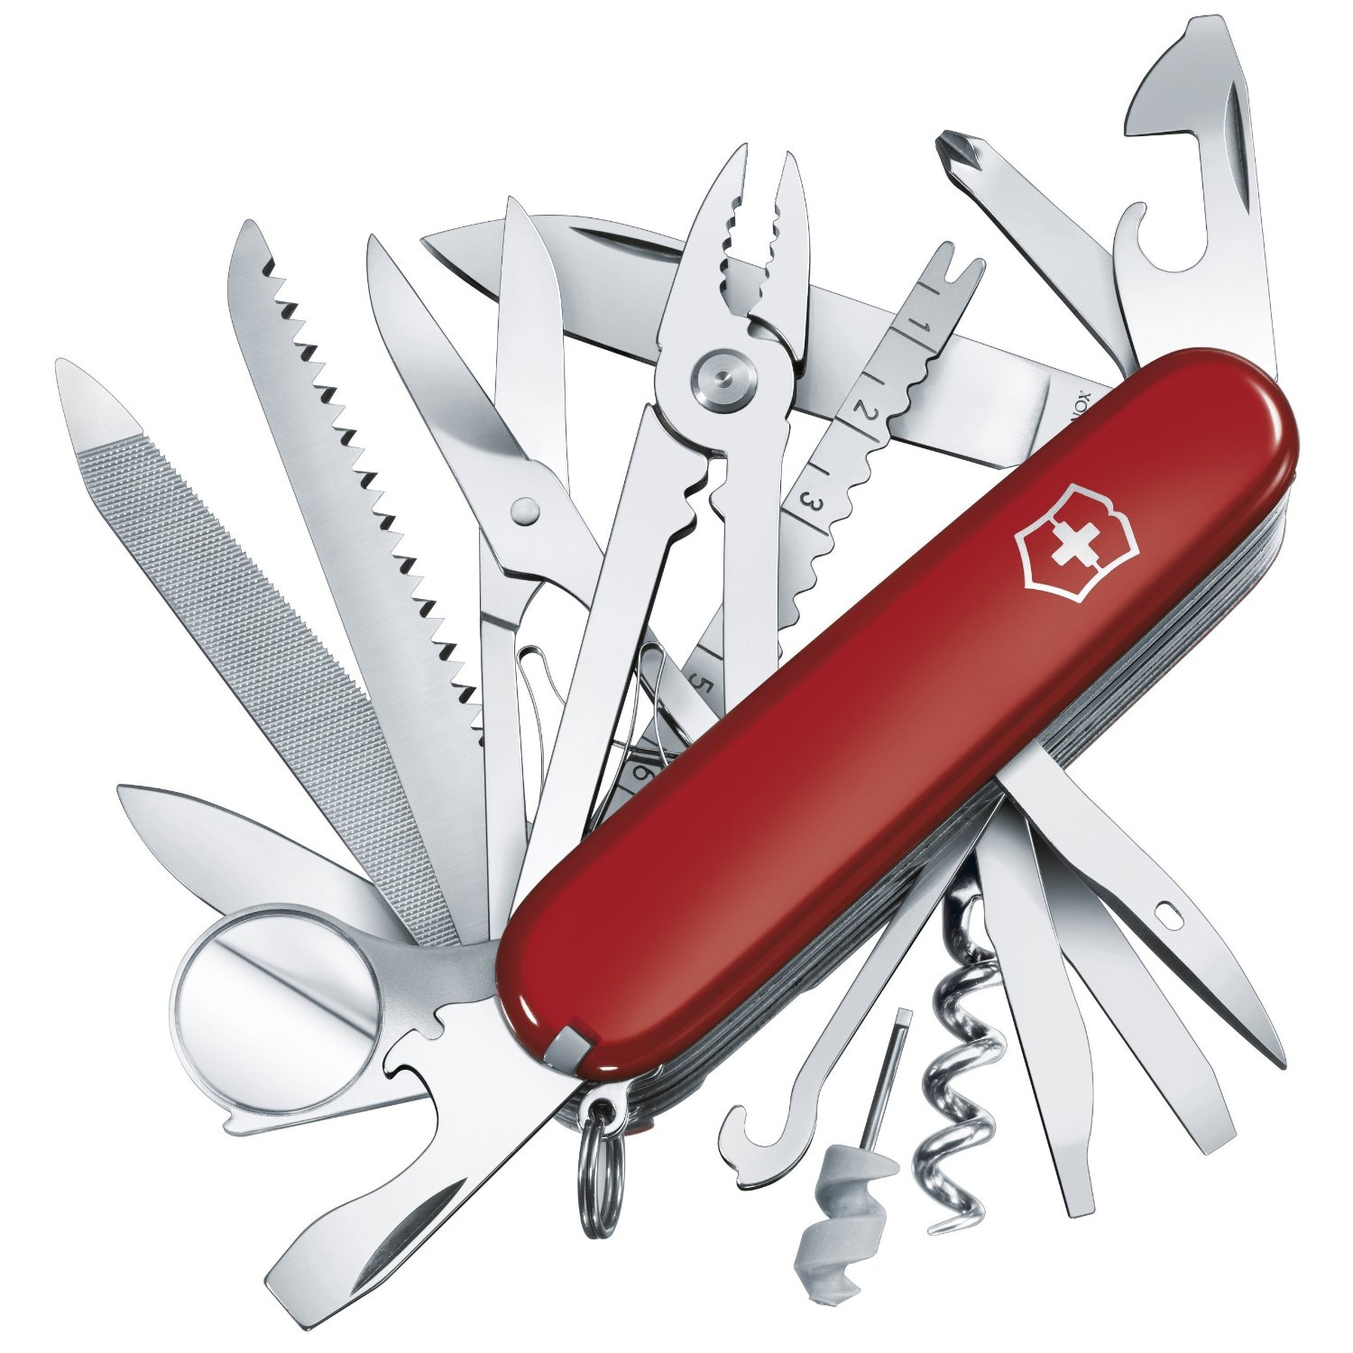
Tools

Slide 55
Visual Studio
Resharper
Xunit
Moq
Nsubstitiute
RhinoMock
Fitness
Specflow

Slide 56
String calculator
Add numbers that is represented using string
For example = “1,2,3,5” = 11

Slide 57
Rules
Write test before writing any production code
Everyone must work in pair
One person should write one failing test and other should make that test pass by writing as minimum code as possible
Refcator code when necessary . You can only refactor code when all tests are in green
Write elegant code

Slide 58
Requirement 1: The method can take 0, 1 or 2 numbers separated by comma (,).
Requirement 2: For an empty string the method will return 0
Requirement 3: Method will return their sum of numbers for two numbers
Requirement 4: Allow the Add method to handle an unknown amount of numbers
Requirement 5: Allow the Add method to handle new lines between numbers (instead of commas).
Requirement 6 : for any non number throw exception
Requirement 7: Support different delimiters
To change a delimiter, the beginning of the string will contain a separate line that looks like this: “//[delimiter]\n[numbers…]”
for example “//;\n1;2” should take 1 and 2 as parameters and return 3 where the default delimiter is ‘;’
Requirement 8: Negative numbers will throw an exception
Requirement 9: Numbers bigger than 1000 should be ignored

Slide 59

Just do it!

Slide 60
Coding Dojo

Slide 61
Some clarifications about TDD
TDD is neither about "Testing" nor about "Design".
TDD does not mean "write some of the tests, then build a system that passes the tests.
TDD does not mean "do lots of Testing."
Test-Driven development is a process of developing and running automated test before actual development of the application. Hence, TDD sometimes also called as Test First Development.

Slide 62
What is coding dojo
A Coding Dojo is a meeting where a bunch of coders get together, code, learn, and have fun
The real point of going to a dojo is to improve your skills
Notes:
Programmers generally love the plain activity of writing code, away from managers and deadlines and production bugs. When they’ve got over their shyness, most are delighted to show others how well they can actually write code, as well as to pick up tips and advice from them.

Slide 63
http://www.meetup.com/OsloCodingDojo/photos/1237021/#21061984

Slide 64
Demo!

Slide 65
Convert Arabic number to Roman Number

Slide 66


Slide 68
What makes an app hard to test?
• Tightly coupled
•Hidden or embedded dependencies
• Required data & databases
• Insane amounts of setup code for the test

Slide 69
Design Patterns
Dependency Injection •
Repository • Data Access • Adapter • Single-Responsibility Principle • Keeps tedious, bug-prone code contained • Strategy • Encapsulates algorithms & business logic • Model-View-Controller • Isolates User Interface Implementation from the User Interface Logic • Testable User Interfaces • Model-View-ViewModel

Slide 70
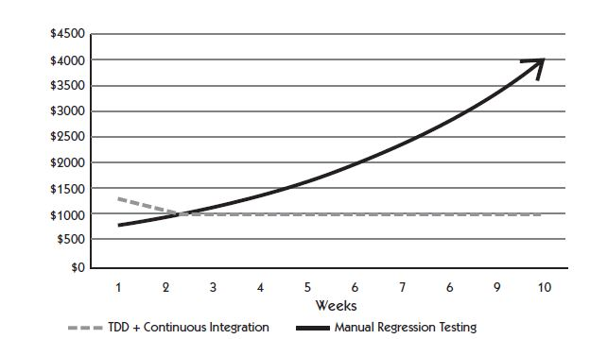
Notes:
As depicted in Figure 1.5, there is an ROI for test automation and continuous integration after some up-front cost. Depending upon the complexity, age,size, and platform an application is built on, the costs to realize a return on investment for build and test automation in the development of the application are different. Over time, the execution of manual regression test suites
will take longer and slow down delivery. This slowdown may result in a reduction of testing to meet deadlines. This leads to a vicious cycle that accelerates the accumulation of software debt in the software that teams must deal with in the future.

Slide 71
You get immediate feedback on if your code is working, so you can find bugs faster
You get feedback on design
You gain confidence to refactor existing code, which means you can clean up code without worrying what it might break
At the end you have a suite of regression tests that can be run during automated builds to give you greater confidence that your codebase is solid
Reduce technical debt

Slide 72
Customer Value

Slide 73
